Slide 1



This is your Presentation Title
Your Name
Guomics Laboratory for Proteome Complexity Science, Westlake University
Westlake Center for Intelligent Proteomics, Westlake Laboratory
guomics.com
Notes:
A central inquiry in biology centers on the coordinated action of multiple protein machineries and their execution of biological functions. To address this, it is essential to complement protein structure analysis with an understanding of in situ protein expression, interactions, spatial localization, and dynamics. Proteomics endeavors to answer these questions. For the past three decades, mass spectrometry-based proteomics has primarily concentrated on protein identification and quantification. In this presentation, I will outline the trajectory of proteomics over the past decade and its prospects for the next decade, followed by a discussion of recent advancements from our laboratory centered on AI proteomics over the last three years. Specifically: 1) To enhance protein identification and quantification, we developed the billion-scale AI-ready MS data corpus, MassNet, which has supported the development of DIA-BERT, DDA-BERT, XuanjiNovo, and OmniNovo; 2) To decipher protein interactions, we established an AI-empowered and robotics-assisted workflow, ProteoAutoNet, for the detection of protein complexes; 3) To resolve protein expression at cellular and subcellular resolution, we conceptualized AI-empowered filter-assisted expansion proteomics; 4) To monitor and predict protein dynamics, we proposed an AI-empowered perturbation proteomics strategy and developed ProteinTalks, the first virtual cell foundation model based on perturbation proteomics. Finally, the research plan will be presented, centered on developing virtual cell models and employing omics-based, AI-empowered approaches for drug discovery.

Slide 2
Outline
1, Add Title
2, Add Title
3, Add Title
4, Add Title
5, Add Title
6, Add Title

Slide 3
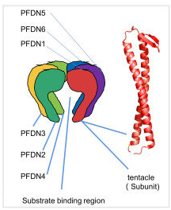
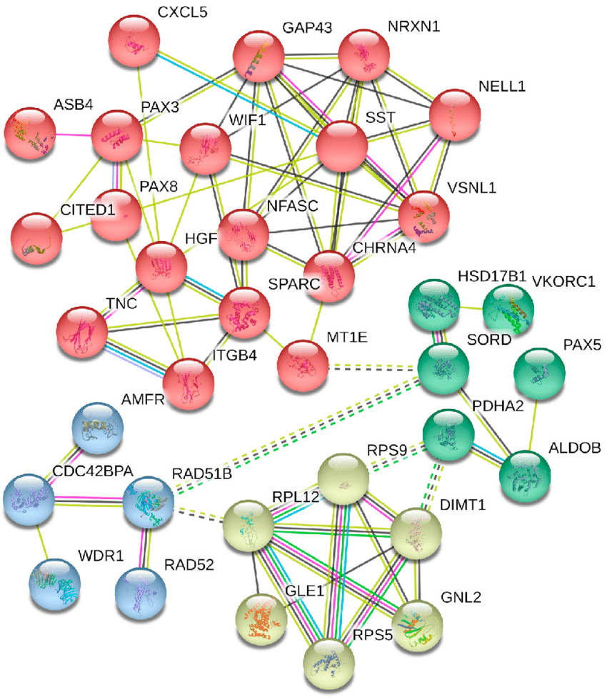
Write here your subtitle
Prefoldin complex
Alzheimer disease-related PPIs
Protein-Protein Interactions (PPIs) - direct physical interactions between two or more proteins
Protein Complexes - a stable or transient assembly of multiple proteins that come together to perform a specific biological function
https://www.researchgate.net/figure/Figures-A-to-C-is-the-prefoldin-complex-formation-process-A-Scattered-prefoldin_fig1_345363768
https://www.researchgate.net/publication/344673028_Systems_biology_and_bioinformatics_approach_to_identify_gene_signatures_pathways_and_therapeutic_targets_of_Alzheimer's_disease

Slide 4
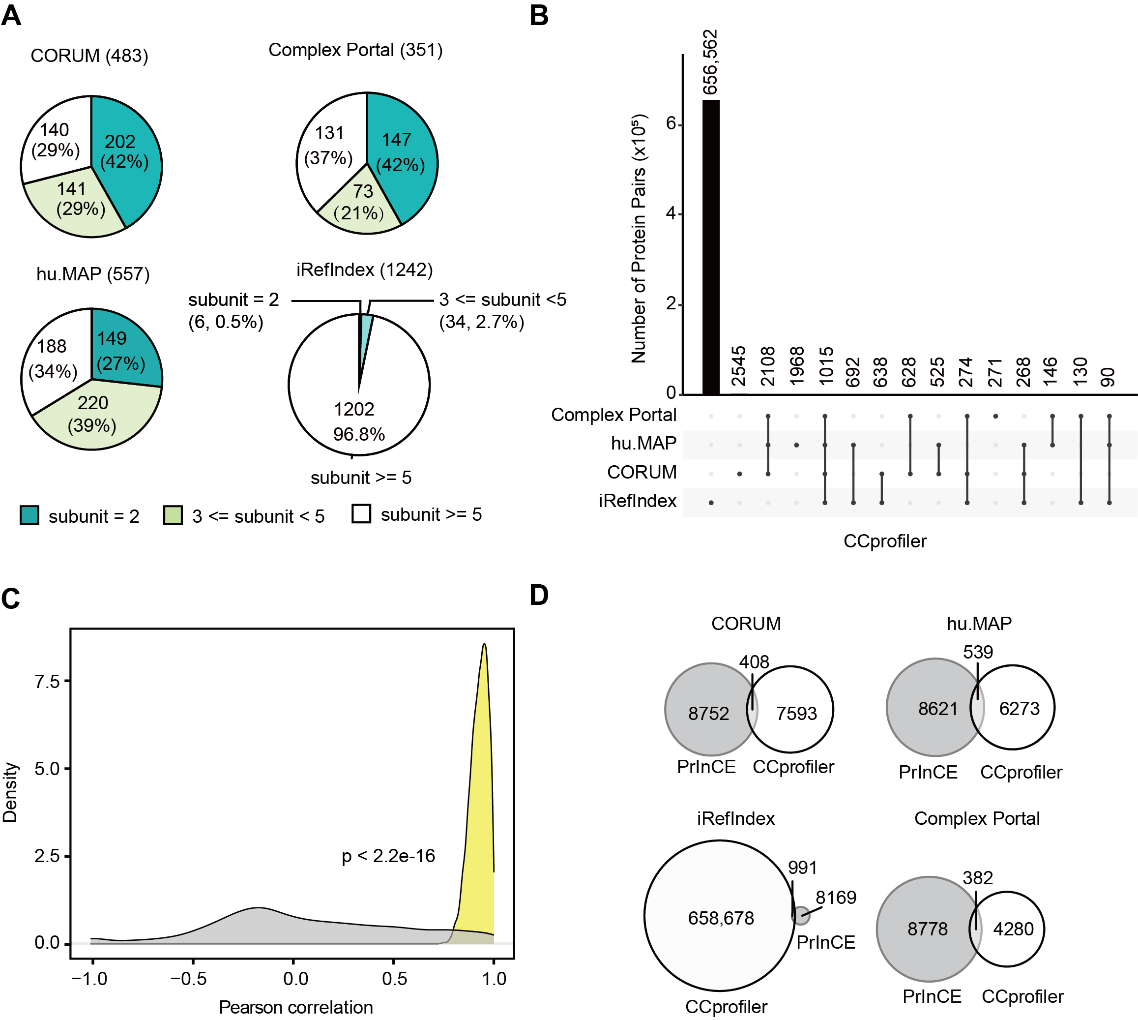
Write here your subtitle
Complexes identified from CCprofiler
Interactions identified from CCprofiler
Complex sizes was balanced for CORUM, Complex Portal, and hu.MAP
hu.MAP shows an advantage in identifying medium-sized complexes.
iRefIndex should be cross-referenced with experimentally validated databases

Slide 5
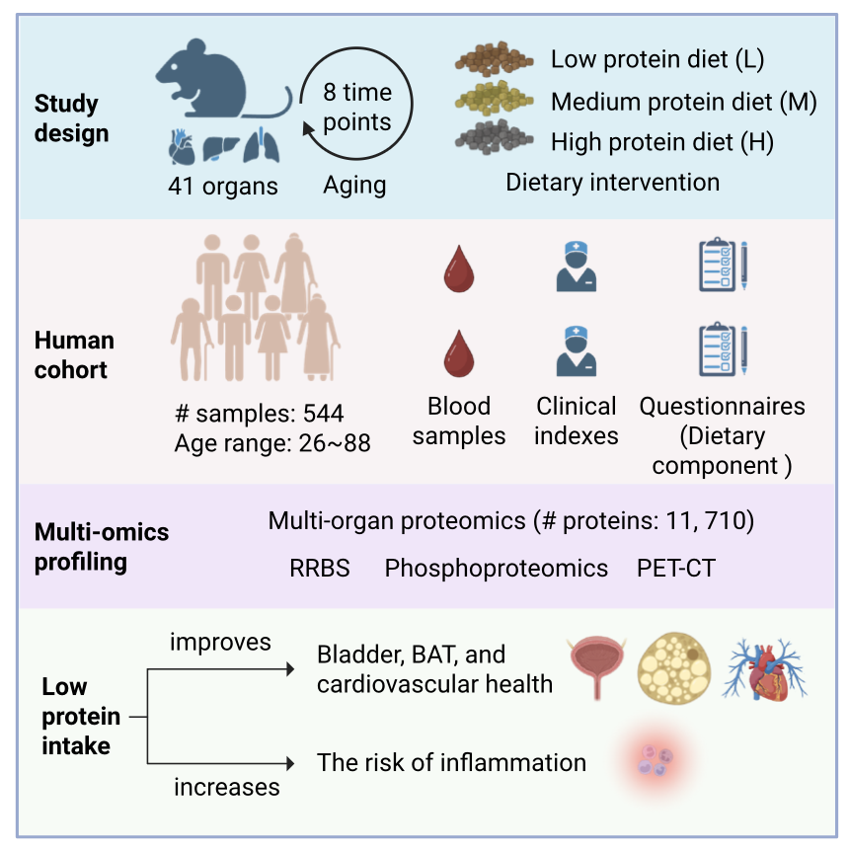
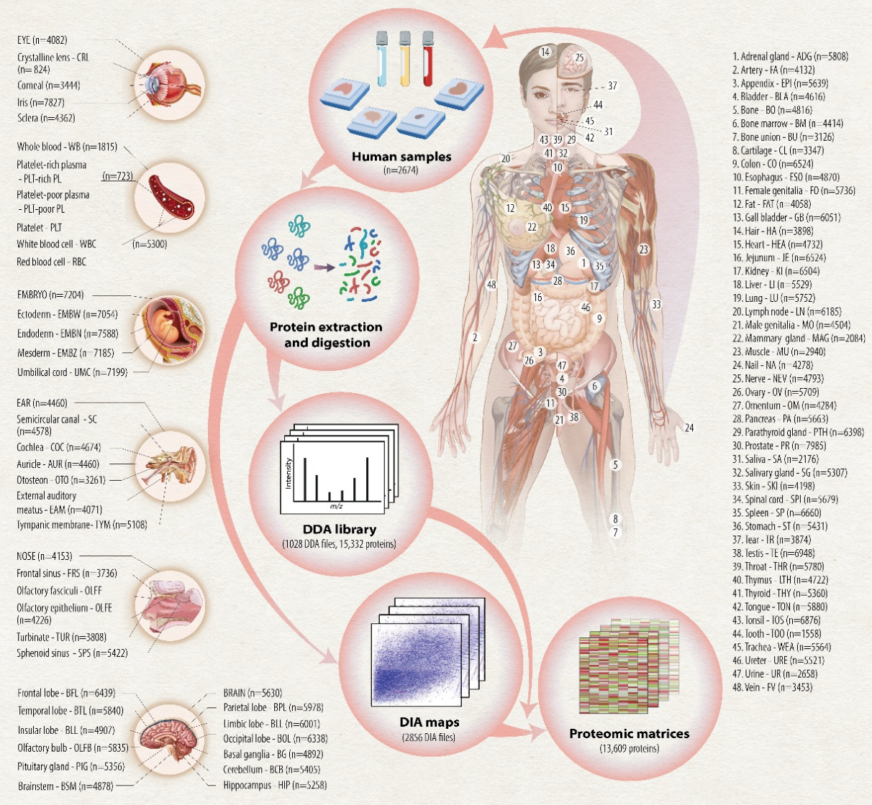
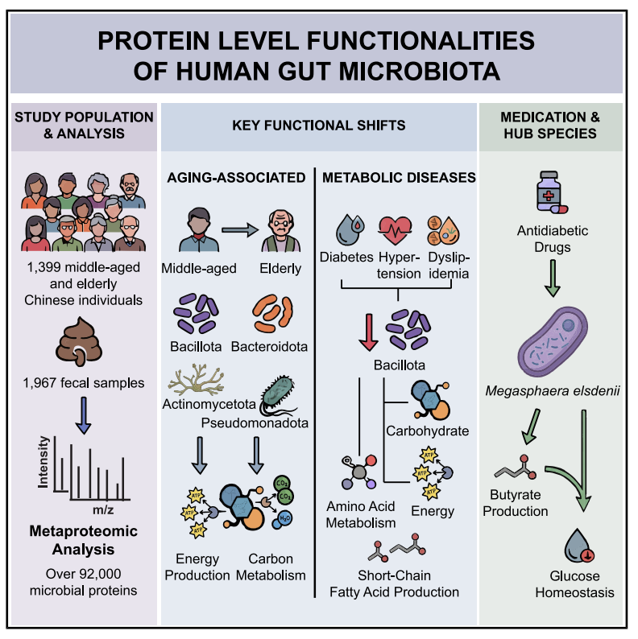
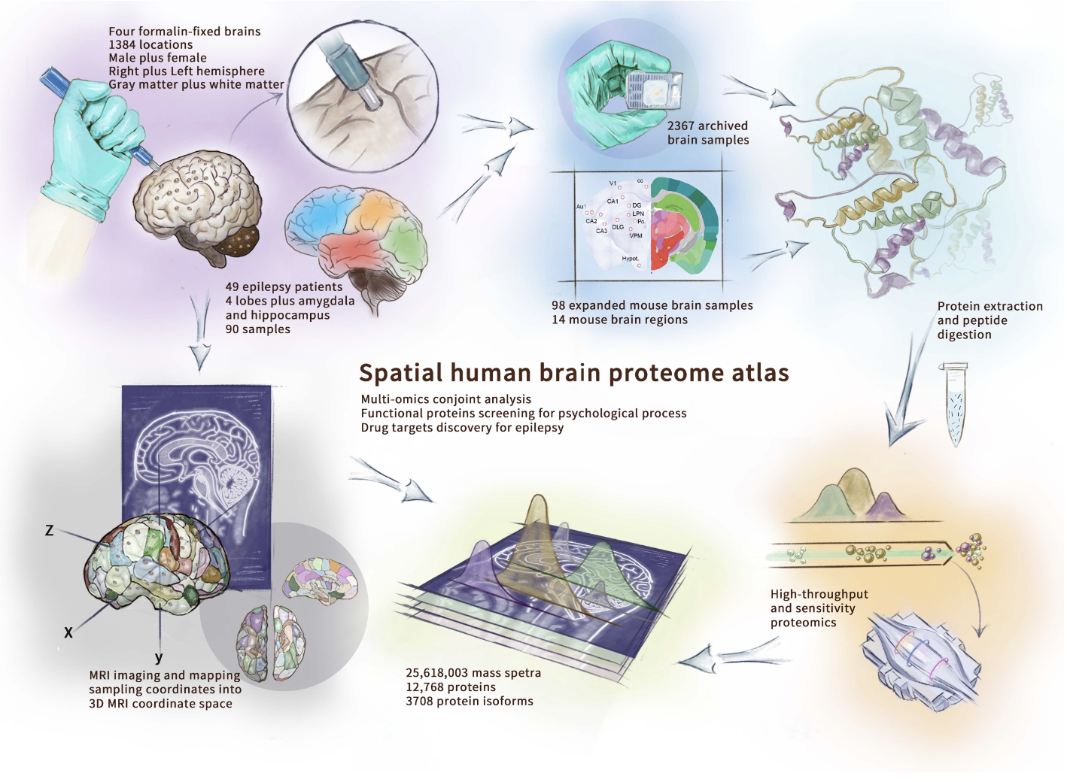
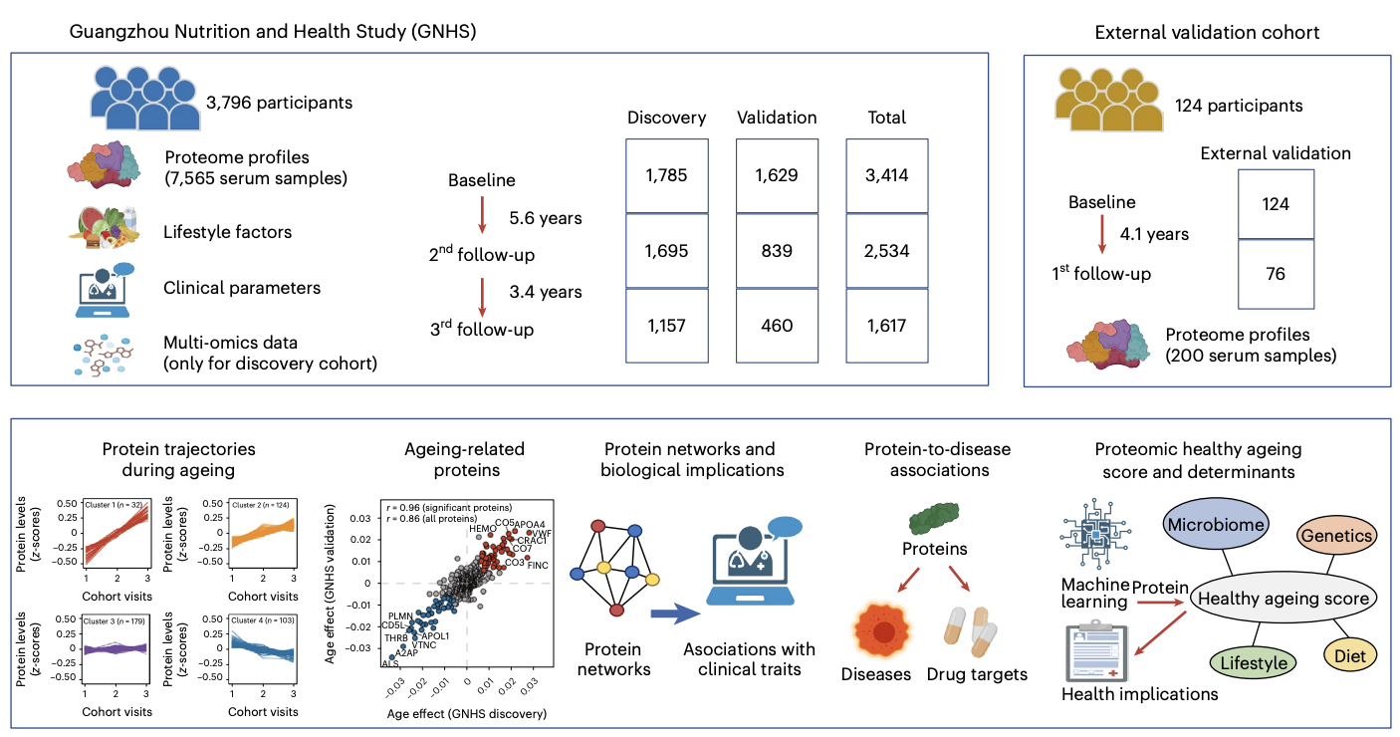
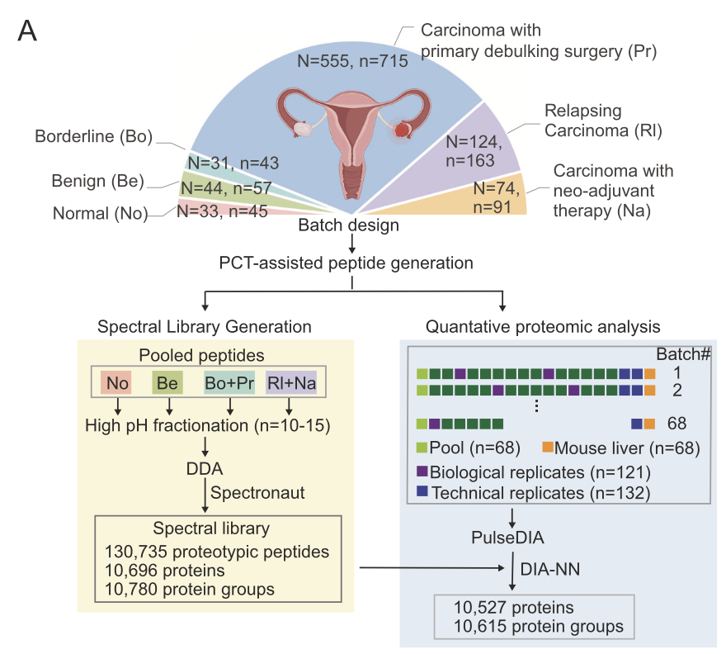
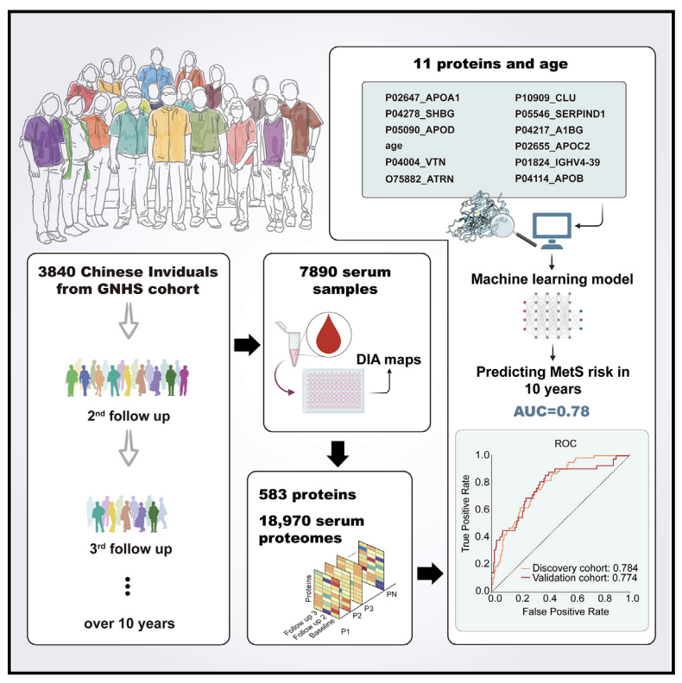
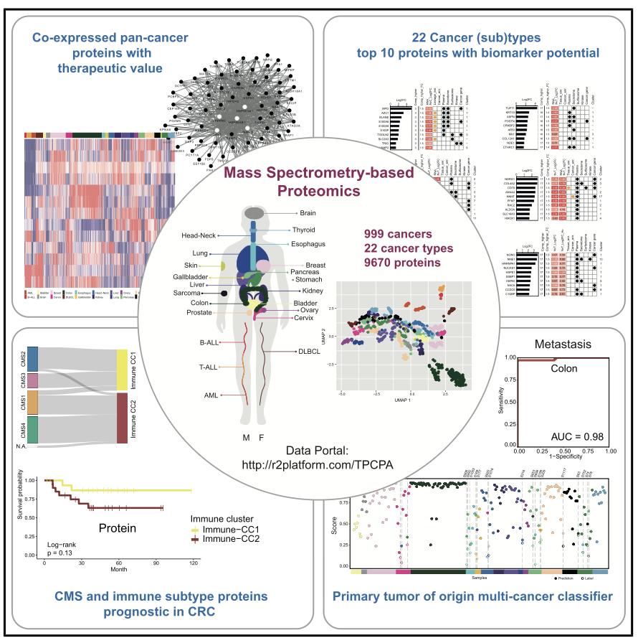
Write here your subtitle
Protein restriction reprograms the multi-organ proteomic landscape of mouse aging
Lu, et al. Cell. 2025
Spatial distribution of the proteome in human body and cancers
Yue, et al. 2nd revision. Nature
Large-scale metaproteomics of human gut microbiota reveals microbial functions in metabolic diseases and aging Liang, et al. Cell Metabolism. 2026
A spatially resolved human brain proteome atlas for decoding brain function and disease.
Xiao, et al. Under review.
Longitudinal serum proteome mapping reveals biomarkers for healthy ageing and related cardiometabolic diseases
Tang, et al. Nature Metabolism. 2025
Proteomic landscape of epithelial ovarian cancer
Qian, et al. Nature Comms. 2024
Population serum proteomics uncovers a prognostic protein classifier for metabolic syndrome
Cai, et al. Cell Rep Med. 2023
The pan-cancer proteome atlas, a mass spectrometry-based landscape for discovering tumor biology, biomarkers, and therapeutic targets
Knol, et al. Cancer Cell. 2025

Slide 6
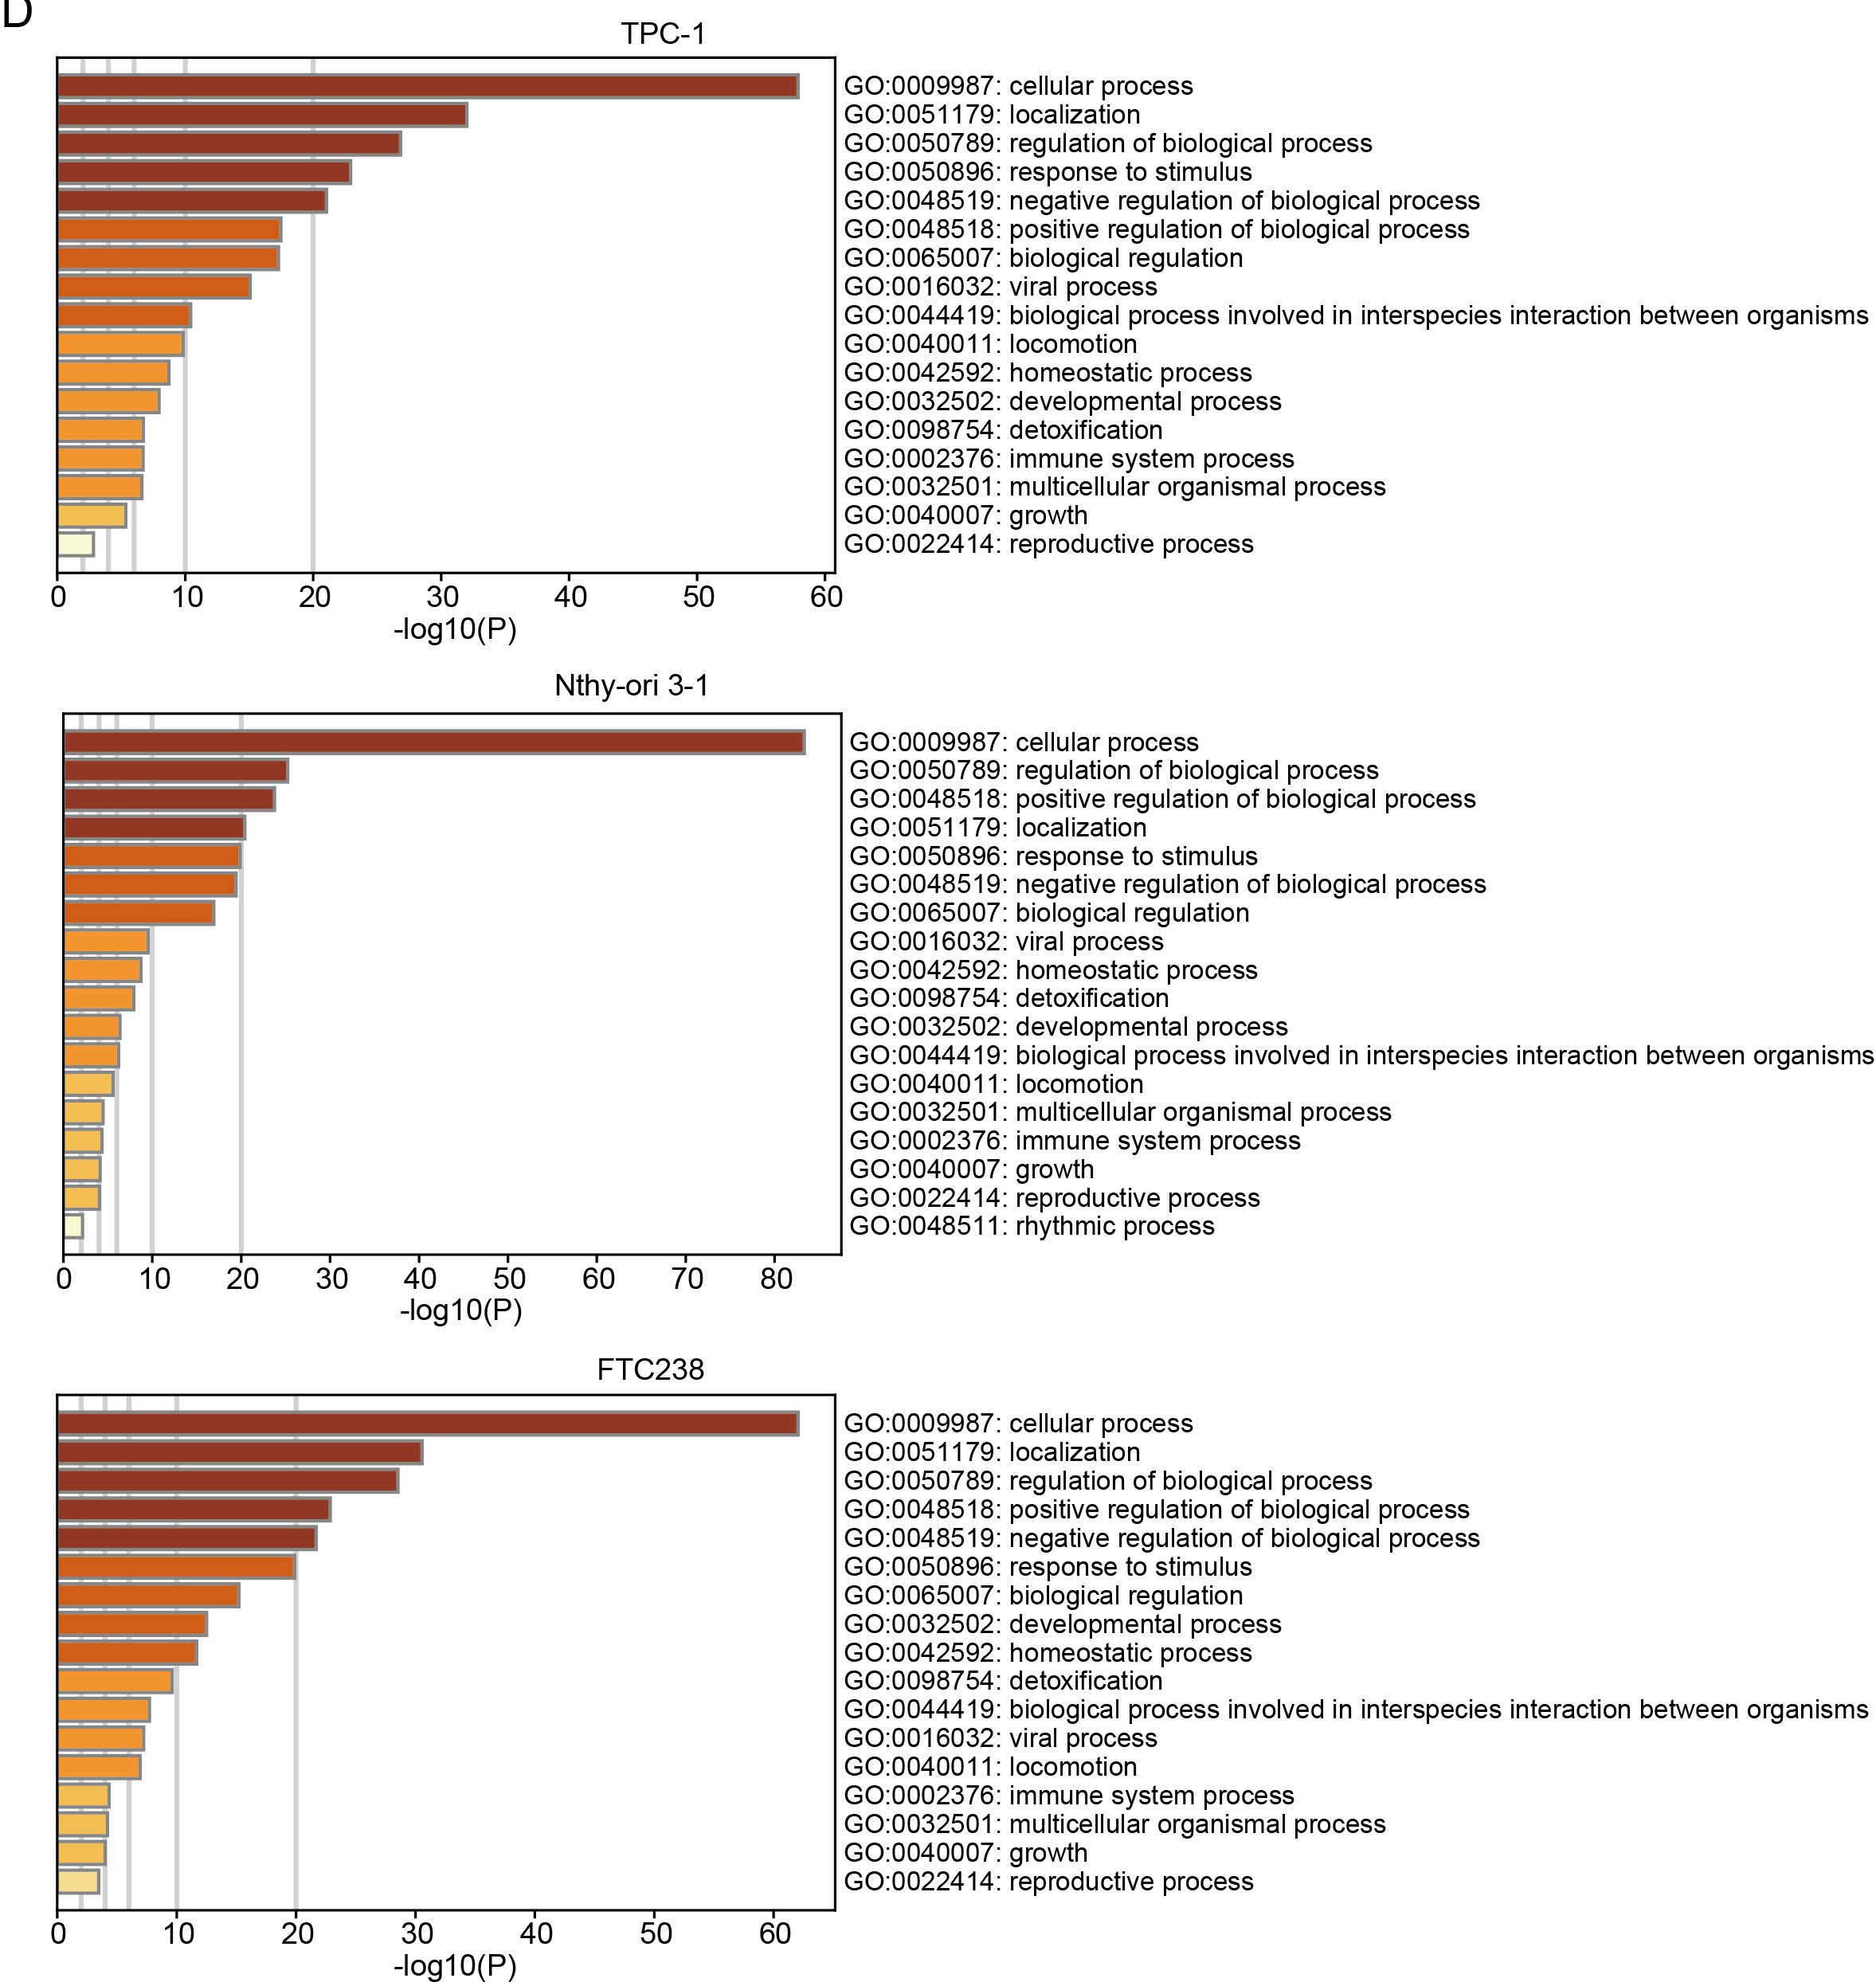
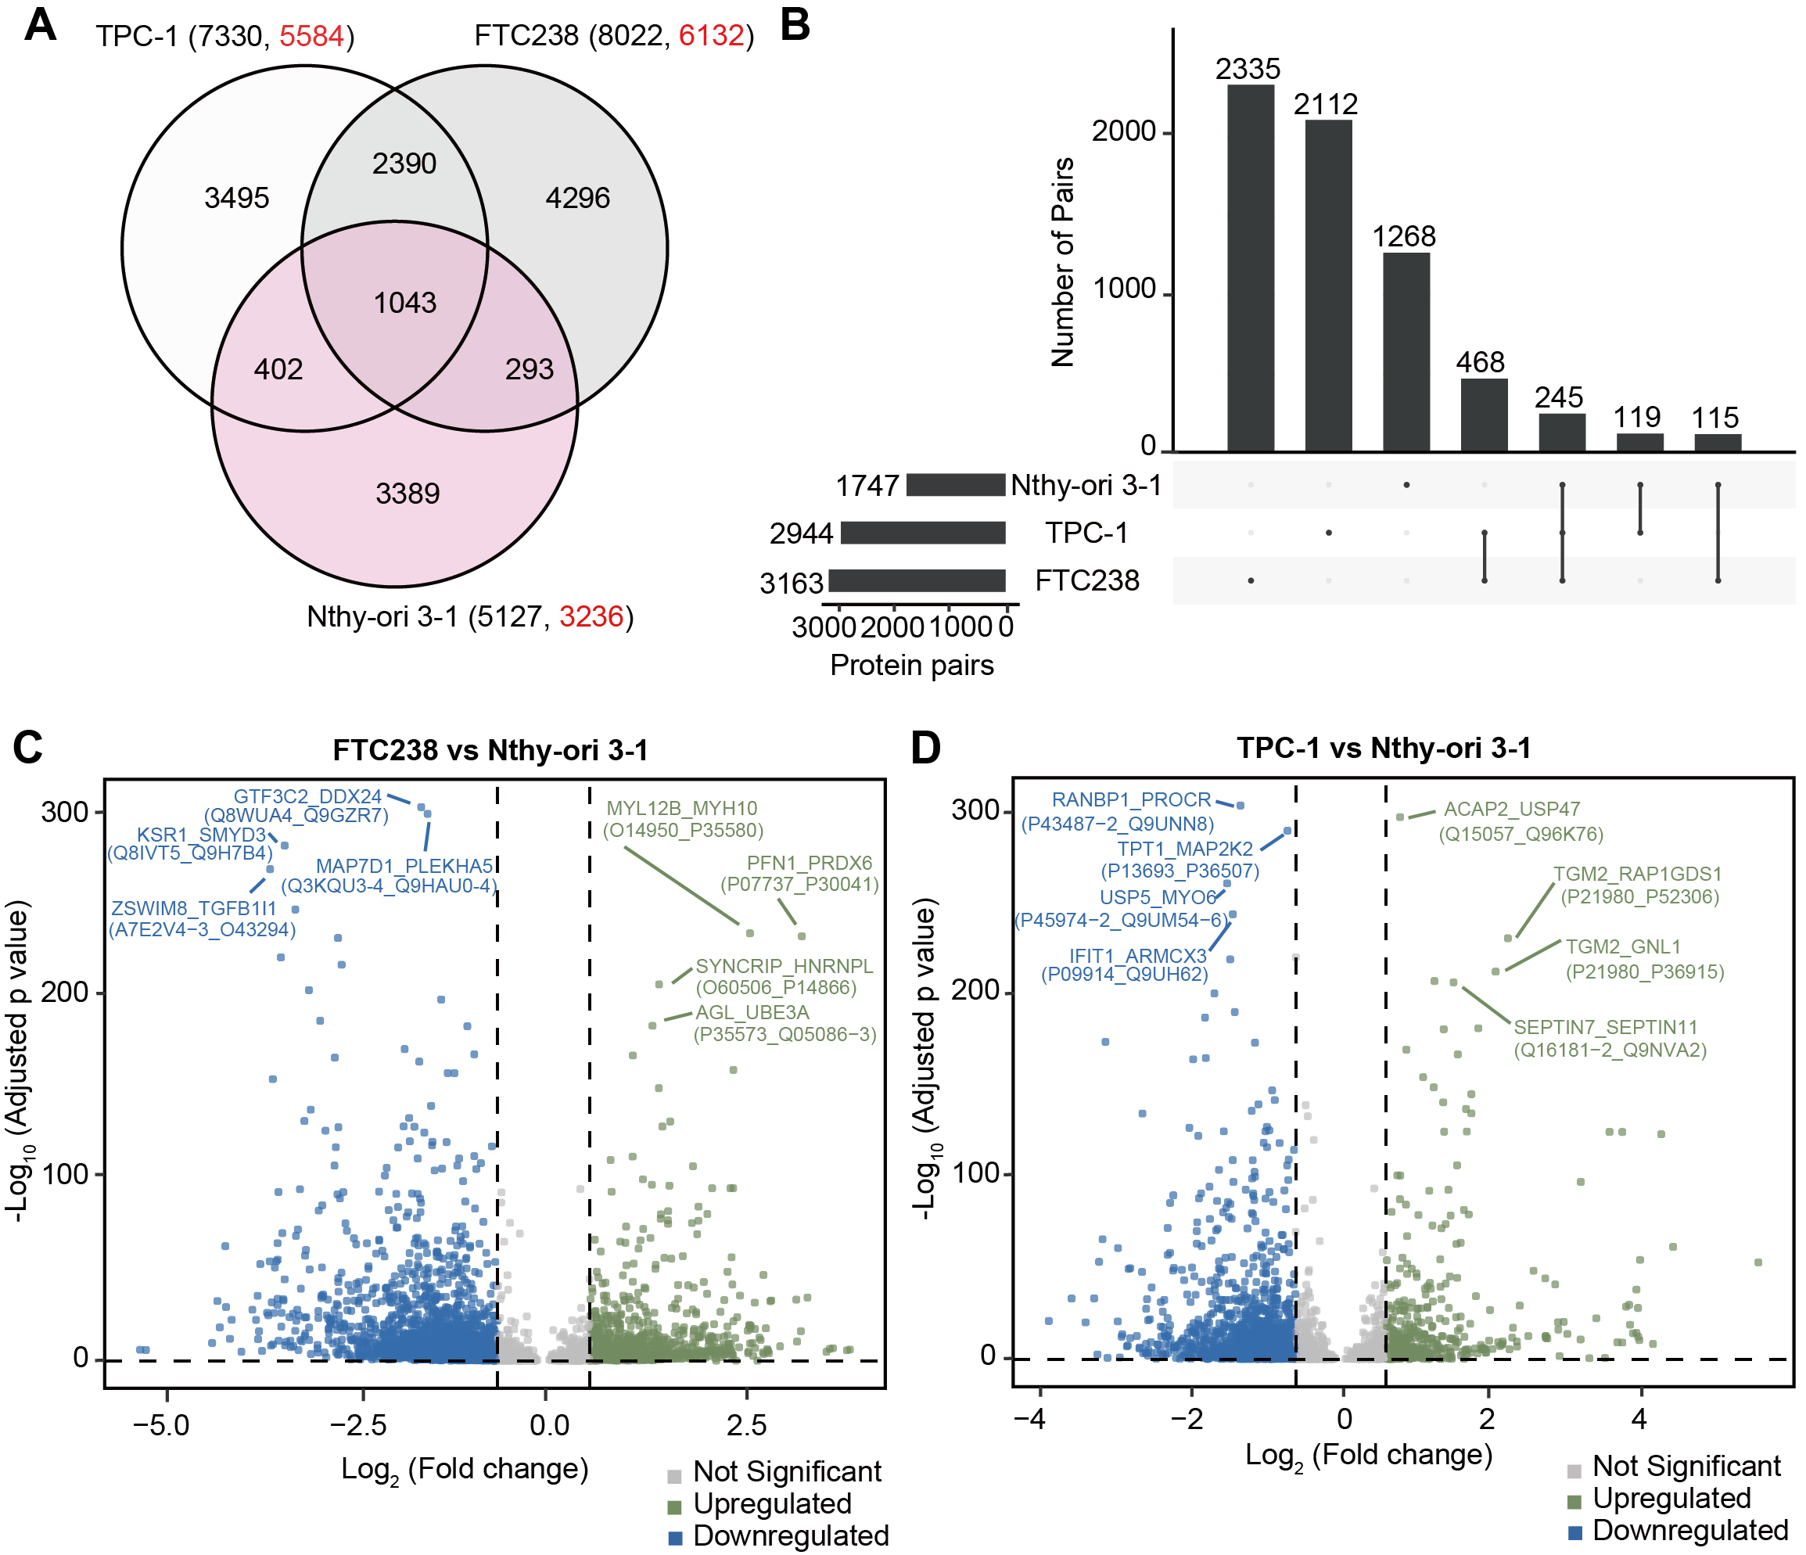
Write here your subtitle
Predicted protein pairs (FDR<20%)
FTC238 identified the greatest number of protein interactions
The enriched GO pathway of the protein pairs was similar among the three cell lines

Slide 7
Write here your subtitle
Predicted protein pairs (FDR<5%)
Nthy-ori 3-1 as control and analyzed the activated PPIs in FTC238 and TPC-1
2138 downregulated and 952 upregulated protein pairs between FTC238 vs Nthy-ori 3-1
1286 downregulated and 479 upregulated protein pairs between TPC-1 vs Nthy-ori 3-1

Slide 8
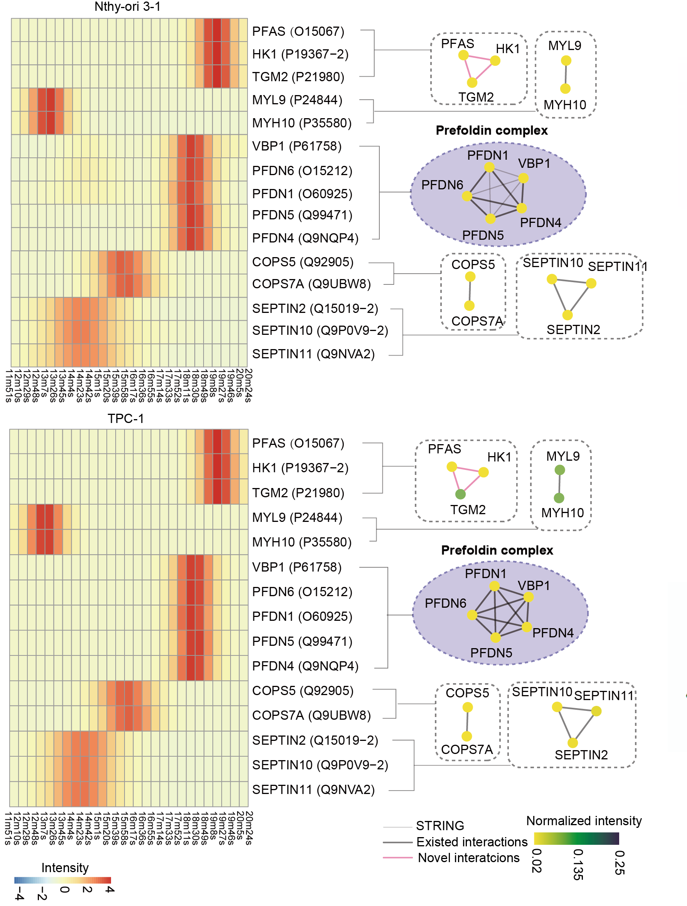


Novel protein interactions
PFAS is a key enzyme in the de novo purine biosynthesis pathway
HK1 catalyzes the first step of glycolysis, converting glucose to glucose-6-phosphate
TGM2 is a multifunctional enzyme involved in protein crosslinking, cell adhesion, and extracellular matrix remodeling
Highlight the metabolic and survival adaptations TPC-1 employ and represent potential therapeutic targets for disrupting tumor progression

Slide 9
Summary
Robotic platform increased throughput by fourfold of sample preparation
Multi-database strategy of PrInCE increased near ninefold for predicted protein interactions

Slide 10

Thanks!
Your Name
Guomics Laboratory for Proteome Complexity Science, Westlake University
Westlake Center for Intelligent Proteomics, Westlake Laboratory
guomics.com

